Slide 1

Wireless Power Transfer
C1C Henry
C1C Hermanson
C1C Pak
C1C Singh
1

Slide 2
Overview
Executive Summary
Technical Discussion - NSTR
Motivation - NSTR
Problem Statement - NSTR
Related Work - NSTR
Methodology
Results
Discussion
Future Work
Questions?

Slide 3
Executive Summary
Discussion of action items researched and completed throughout this sprint.
Review significant developments and existing challenges related to the research.
Consider the next phase of research and look ahead at long-term goals of this capstone project.
Review what WPT is and the vulnerabilities associated with it.
Discuss progress experimenting with its exploitation and how that information is planned to be used.
Consider the long-term implications of this capstone project.

Slide 4
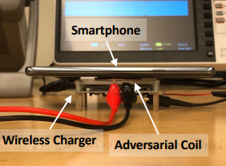
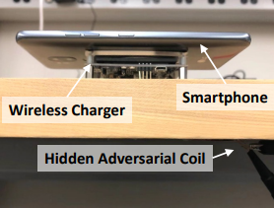
WPT Attack Vectors - Review
Hijacking
Injection of adversarial magnetic signals on the power transmitter to hijack the communication channel
Disruption of magnetic field (via well crafted injection) between transmitter and receiver – cause inefficient power transfer
Control of power transfer process
Eavesdropping
Qi has lack of encryption and authentication mechanisms
Snoop communication between transmitter and receiver
Infer activity of receiver device
Q ID & C allows basic device identification

Slide 5
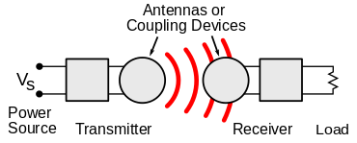
Technical Discussion
WPT is wireless point to point transmission of electrical energy
Many implementations but Qi is the industry standard
Alternatives: AirFuel, Proprietary Near Field Magnetic Coupling, RF, Ultrasound
Delivers a variable amount of voltage to device depending on power requirements
New technology that lacks security capabilities and has vulnerabilities
Malicious messages can be sent between transmitter and receiver to alter power transmission
Messages between transmitter and receiver can be observed to gain information about receiver

Slide 6
Motivation
Wireless Power Transfer could become a common function of new technology
Exploit techniques and results found in this experiment can potentially be generalized
This research will create a foundation for further experimentation and TTP development
Findings can be expanded to other wireless non-networked point-to-point connections

Slide 7
Problem Statement
IDENTIFY
Vulnerabilities
How to exploit
How to defend
APPLY
Proof of concept – hijacking
Proof of concept – eavesdropping
Interpretation of results
EXPAND
Provide research to NRO
Observe various side channel-attacks
Create security mitigations – Software Based Encryption
Expand to larger technologies

Slide 8

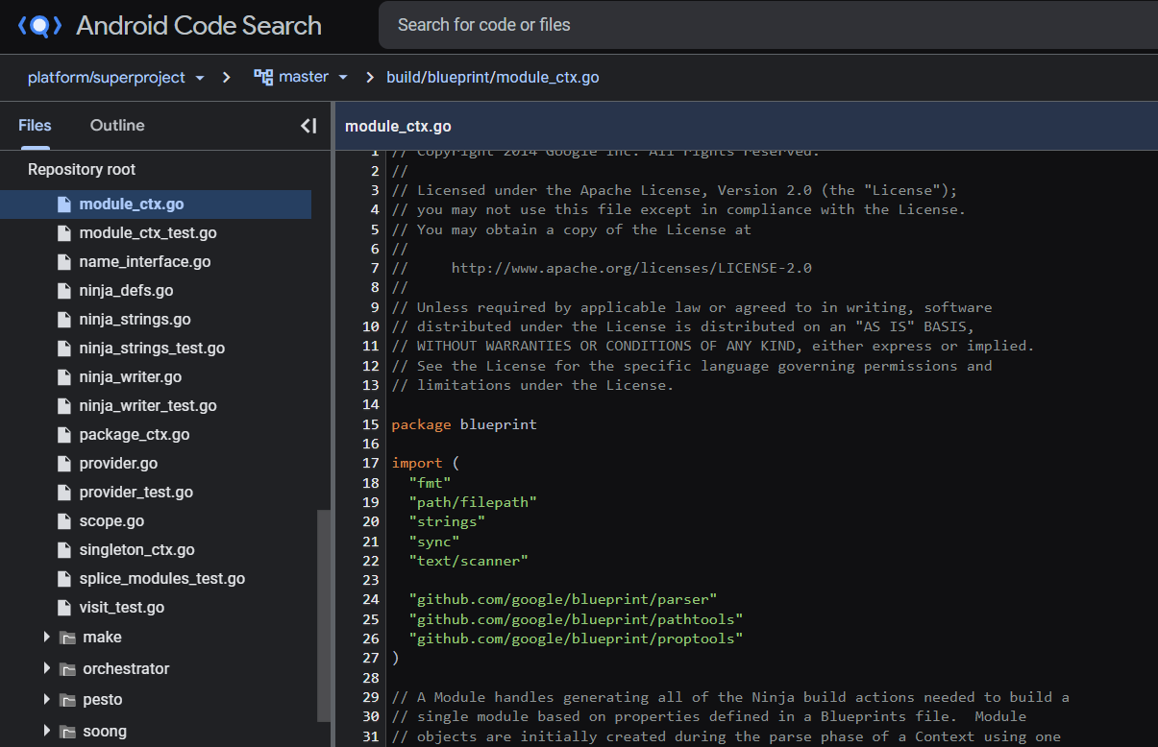
Android OS
Android Open Source Project
Mirror of existing build – contains previous builds
Android Code Search
Tool – allow developers to view Android source code

Slide 9

Android OS
Viewed and analyzed OS source code
Searching for how the Android operating system interacts and interprets, if at all, any incoming Qi communications.
No prior publications found – researched from ground up
Cumulative Time Spent: ~32 Hours

Slide 10
Android OS
Findings:
No evidence to suggest that the OS controls the process overtly (besides normal battery function and recognizing that the phone is receiving power).
We do believe that our findings give us enough of a confirmation to conclude that this vector is not a real possibility for this group to pursue.
OS is unlikely to be anything more than severely limited.
Best vector for attack using this technology will remain as voltage analysis (side channel attacks using voltage) and as denial-of-service style attacks using injection methods.

Slide 11
Packet Analysis
Research on Qi Packet structure was conducted using the 2017 Wireless Power Consortium
Checksum and Header provide critical information
Header describes specifically what type of message is being sent between the transmitter and receiver
Checksum validates the message
Several message types were discovered that could be used as signatures once Qi sniffer is acquired
End Power Transfer Packet – Provides information on why a transmitter has stopped transmitting power
Charge Status Packet – Provides a number between 0 and 100 indicating current battery percentage
Identification Packet – Contains code specific to receiver manufacturer and provides a serial number for the device
General Request Packet – Requests a specific packet to be sent from receiver
Transmitter Identification Packet – Contains code specific to transmitter manufacturer and provides a serial number for the device

Slide 12
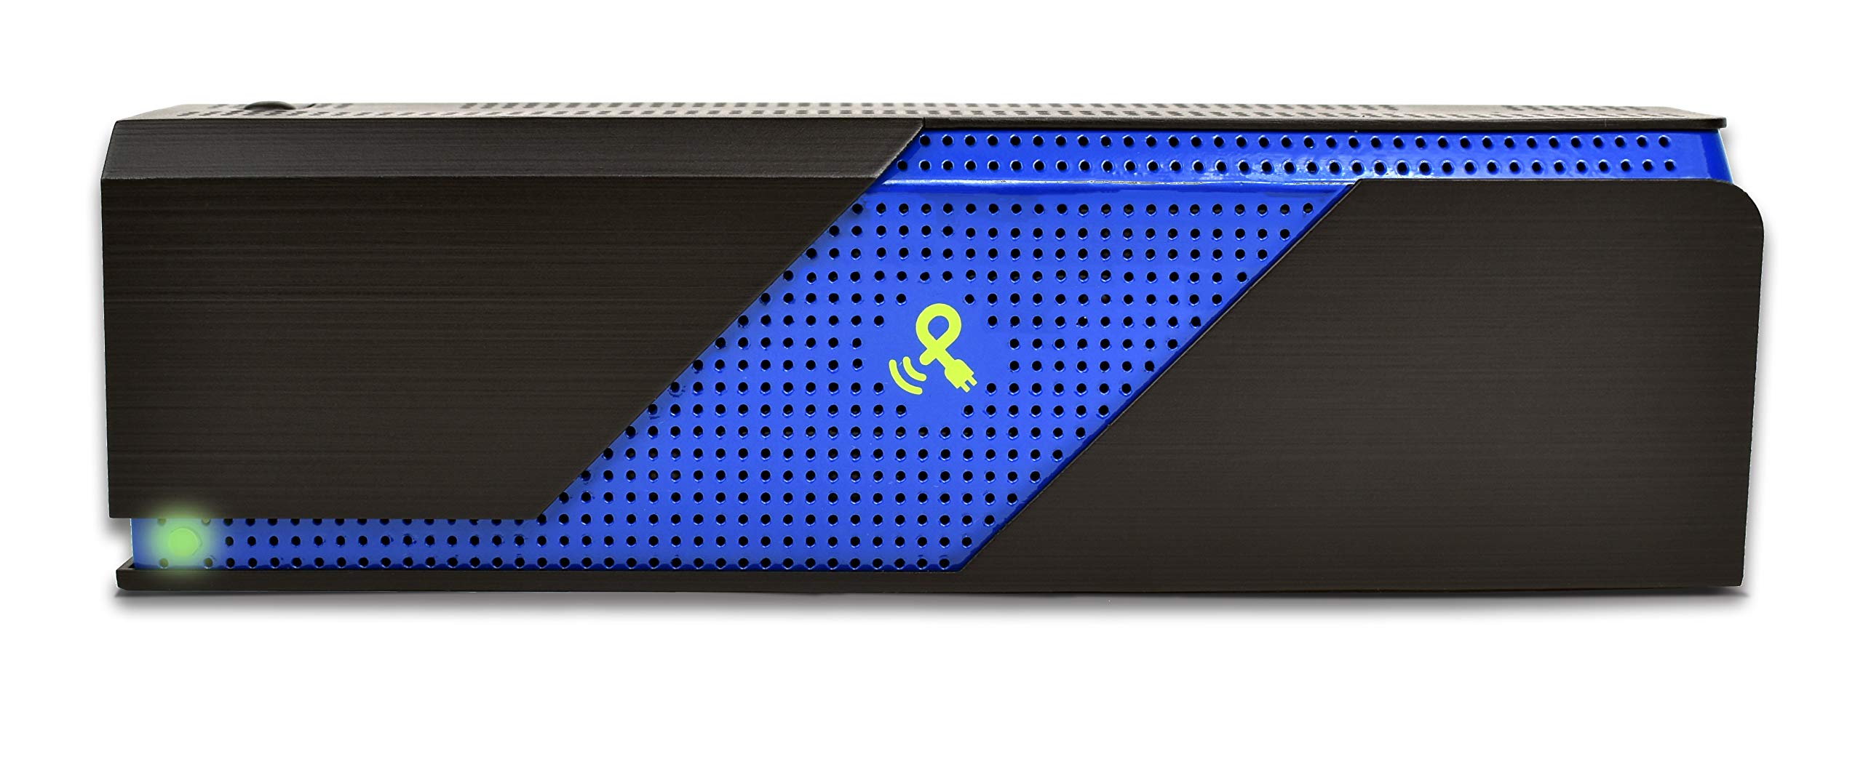

Power Spot – Wireless Power Transmitter
Does not utilize the Qi Standard
Transfer via RF – 915 MHz ISM Band
Provided insight into wireless charging
Captures of the power spot charging did not reveal significant data transmission in relation to Qi packet transmission.
Not as widespread as Qi
More limited in use. Interesting point of research for power transfer phase

Slide 13
Software Based Encryption: Authentication
"Secure Energy Encryption for Wireless Power Transfer"
Setup. Given a security parameter λ, DA outputs a prime p, a master key and a list of system parameters
Partial Private-KeyGen. DA queries for the ID of RN and TN, and chooses a list of system parameters, master key and the received identity of RN and TN(IDu) to generate a partial private key as IDk
RN and TN generate a secret key and public key given the params and partial private keys
Key Exchange – interact with params, private/public keys, and partial keys to exchange session key K

Slide 14
Software Based Encryption
Energy encryption scheme for MRC-based WPT systems ("Energy Encryption for Wireless Power Transfer")
Simulation results (MATLAB/SIMULINK)

Slide 15
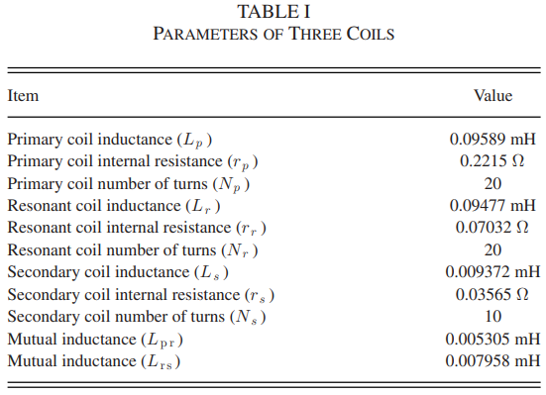
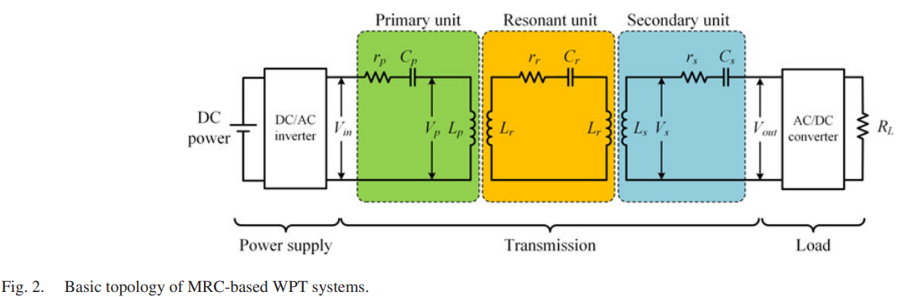
Software Based Encryption

Slide 16
Software Based Encryption
Encryption Scheme Procedure
1. generate encrypted switching frequency ω = δiω0
ω0 = switching frequency of power supply
δi is chaotic security key
2. primary coil frequency regulated to ω0
3. Transmitter in standby until request from authorized receptor
4. resonant and secondary capacitors synchronize

Slide 17
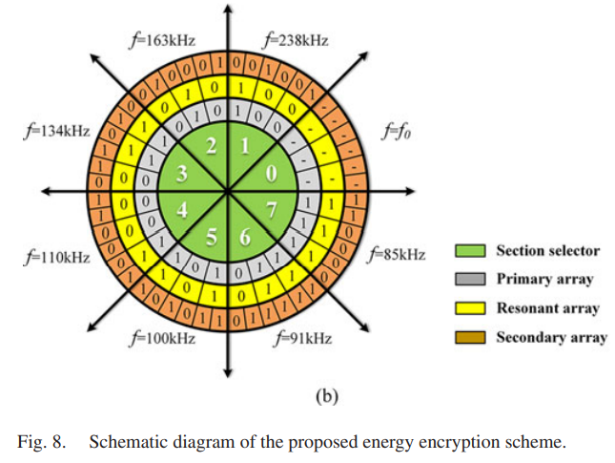
Software Based Encryption

Slide 18
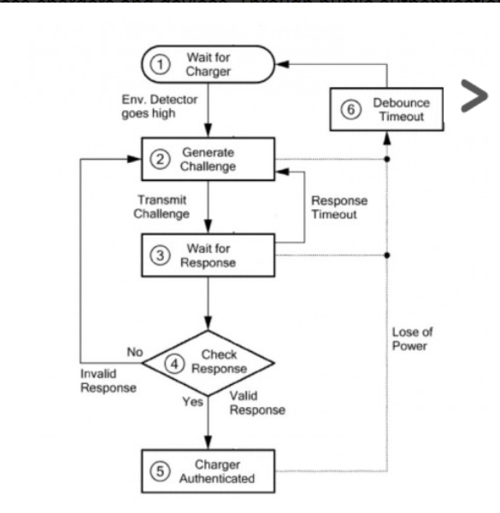
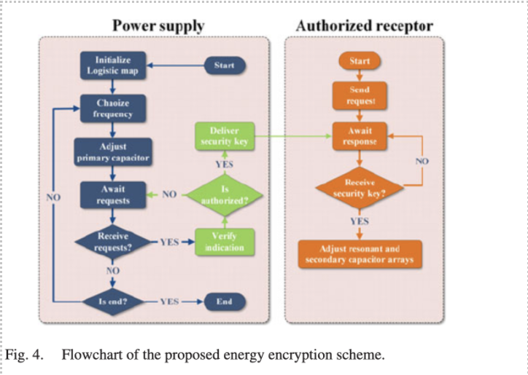
Bluetooth: Software Based Encryption
https://ieeexplore.ieee.org/stamp/stamp.jsp?arnumber=7976787

Slide 19
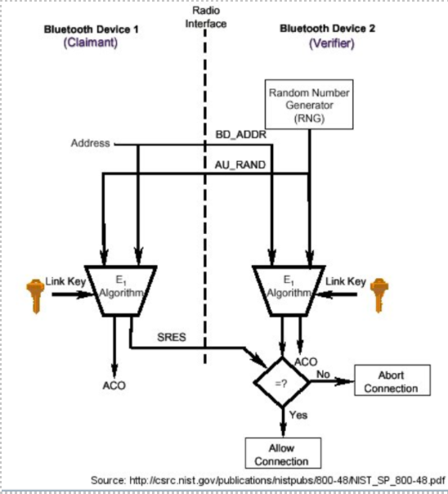
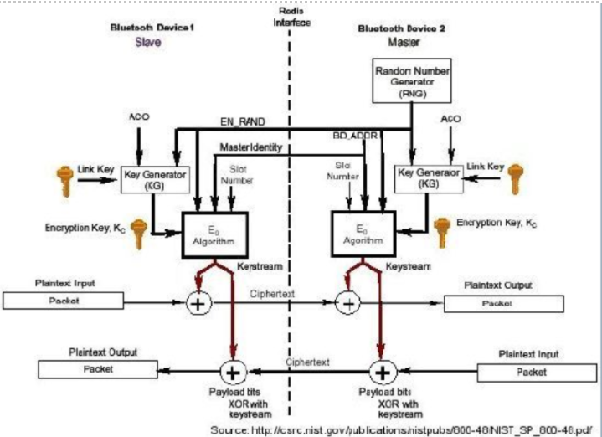
Software Based Encryption: Bluetooth
https://cs.stanford.edu/people/eroberts/courses/soco/projects/2003-04/wireless-computing/sec_bluetooth.shtml

Slide 20
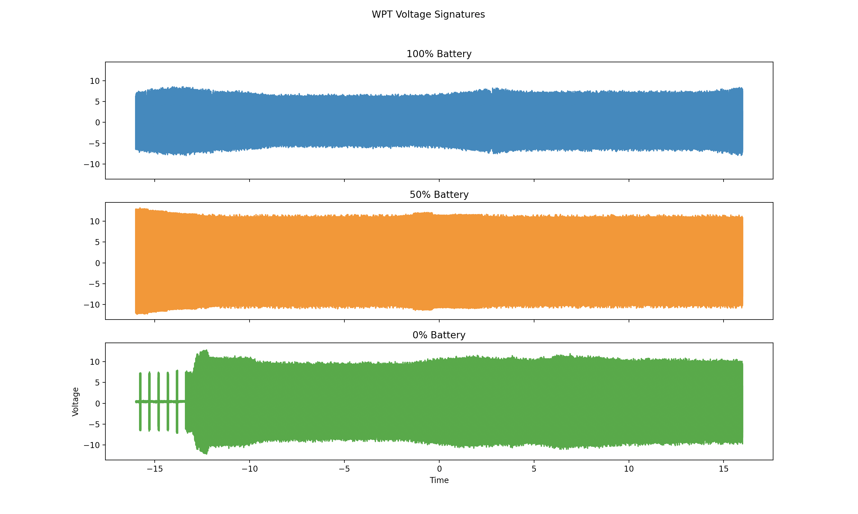
Signature Analysis
Voltage readings taken at three different battery percentage values (100%, 50%, 0%)
.csv files loaded into python plotting program
Voltage differences noticed in 100% battery charging
Individual samples (not averages)

Slide 21
Results Summary + Discussion
Android OS
No further research suggested, rule out IOS
Power Spot Wireless Transmitter
RF Power Transfer vs Inductive Wireless Power Transfer (magnetic fields)
Clear differences in power transfer
Software Based – Authentication
Basic key exchange created by transmitting node
Software Based – Encryption
Chaotically regulated encrypted switching frequency
Signature Analysis
Identified discernable variances in data gathered at different thresholds
Need to work on quantifiable differences

Slide 22
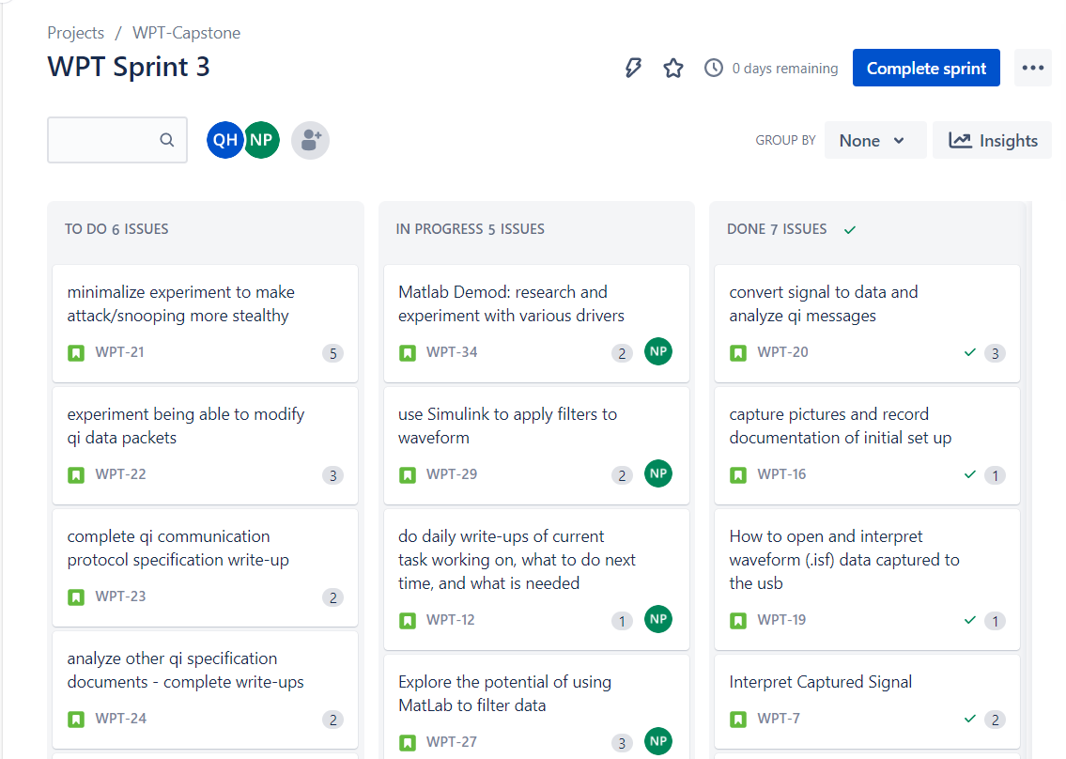
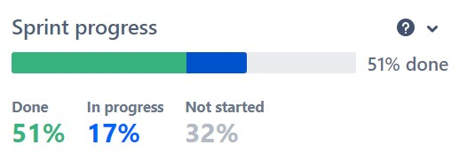
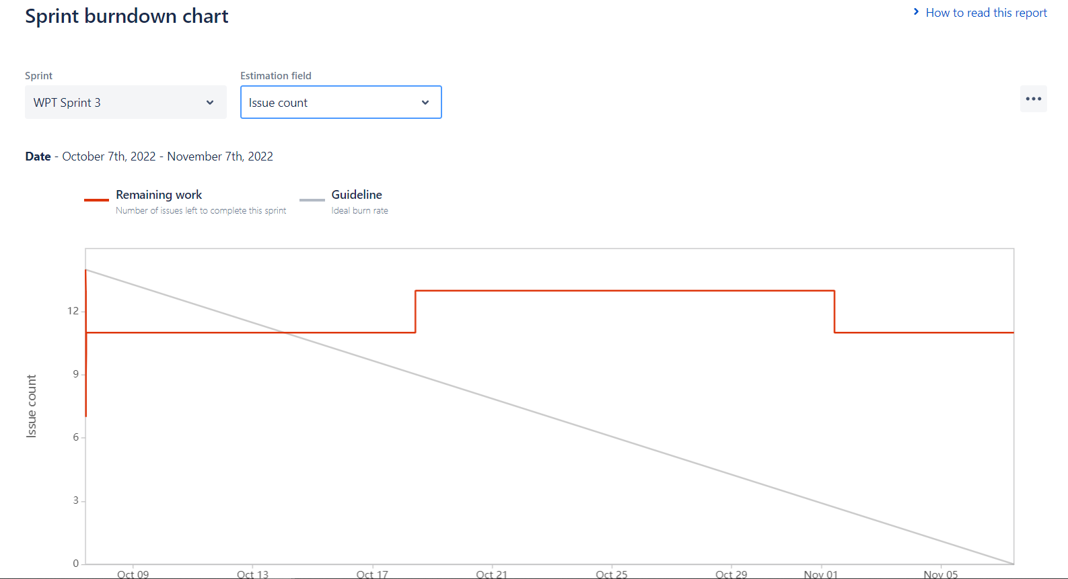
Sprint Organization
Utilized Jira Software to track the sprint process

Slide 23
Sprint 4 Taskers and COAs
Sprint 3 Recaps:
Packet Sniffer Acquired
Expand Snooping Research
Differentiate applications – based on power usage
Extract data from communications
In depth packet analysis (identifiers, etc)
Extract user input from receiver
Injection Development
Craft Hardware
Develop Signal
Experiment with timing

Slide 24
Sprint 4 Taskers and COAs
Matlab encryption simulation
Simulink
Bluetooth Analysis
Ubertooth One – traffic capture
Bluetooth Tunneling applications
E0 Stream Encryption Algorithm
GSM Based Wireless Power Transfer

Slide 25
Future Work
Modification of Qi packets
Qi communication packets are interpreted on the receiver device, modification of the data component within the Negotiation Phase may allow code execution or data exfiltration on the receiver device
Applications with laser-based point-to-point communication
Development of Qi Protection Mechanisms
Hardware or Software based cryptography
Injection/packet modification detection

Slide 26
Questions?

Slide 27

27

Slide 28
Discussion
Qi 1.3 added hardware based authentication in an attempt to ensure power transfer above 5W is coming from a "certified" source. This however does not solve any problems associated with unencrypted data transfer or spoofing the authentication messages.

